Slide 1



AGPT SESSION 1
Trainer Name and Credentials

Slide 2

•The Adoption Preparation Curriculum was created by Harmony Family Center’s ASAP (Adoption Support and Preservation) Program in 2008, and updated and revised in 2024.
•The ASAP|GSAP Program is funded by the Tennessee Department of Children’s Services.
•Harmony ASAP staff provide Adoption and Guardianship Preparation Training opportunities statewide.
•The training is designed to help deepen awareness and understanding about yourself and your child and to help build a strong foundation and lasting commitment for families who pursue adoption/guardianship.

Slide 3





Pre and Post Adoption/Guardianship Services
In Home Counseling
Virtual Adoption Support Groups

Slide 4



Statewide F.U.S.E. Adoptive Family Events
Adoption-Focused Educational Offerings
Case Management /Community Referrals

Slide 5



Relief Team Building
Adoptive Family Camps
Crisis Intervention Support

Slide 6

Objectives
  Exploring Expectations about Adoption
  Common Fears of Adoptive Families
  Differences in Parenting Adopted and Biological Children
  Questions and Reflections

Slide 7

Adoption/Guardianship is not a one time event.

Slide 8

Notes:
As they grow, children and families will process the meaning of adoption through various developmental lenses, revisiting and reprocessing the implications of adoption personally and on the broader society. In each developmental phase, adoptees and their families will likely gain new understandings, grieve newly contextualized losses, and have further questions regarding their history, identity, or family of origin. Often these shifting perceptions of adoption are accompanied by social, emotional, and behavioral challenges, and families may need professionals well-versed in adoption competency to provide services and support. Prospective adopters should also be aware that common family issues such as divorce, death, relocation, or the addition of other children to the family may be particularly disruptive due to a child's previous history of trauma and loss. Families must make a deep commitment, not only to a one-time change in their family after placement, but to understanding the impacts of adoption throughout their lives and even intergenerationally.

Slide 9

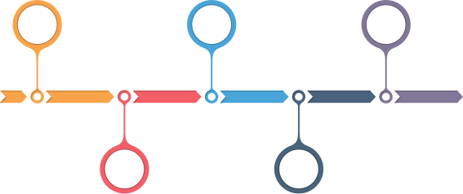

Permanency
Notes:
Research tells us that Support for adoptees and adoptive families is often needed at various times throughout the life span.
One of those times is transition into permanency....
We will start with self reflection.

Slide 10
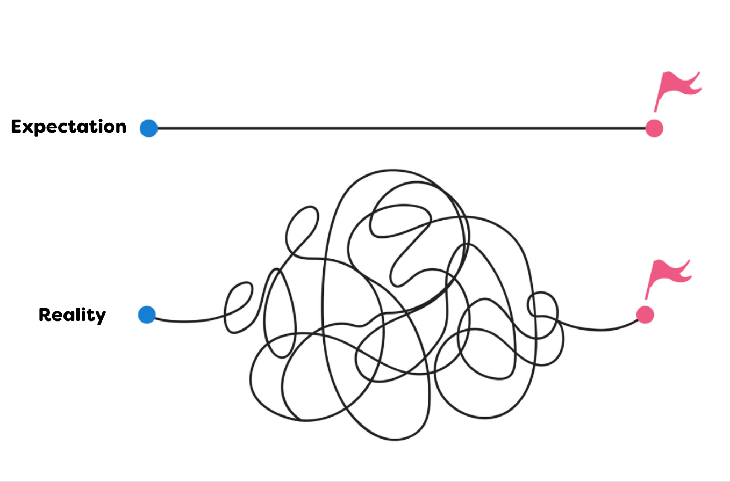
Notes:
So many of us enter in to foster care and adoption without a good grasp on the challenges and the complexities adding a child into your family.
And what can happen when expectations aren’t in alignment with reality, is we end up feeling disappointed or frustrated, angry, unfulfilled.
And while there's no singular adoption experience, the research makes it very clear that families do best when they have healthy and appropriate expectations of adoption.

Slide 11
"One of the best predictors of placement stability and healthy parent-child relationships in adoptive
families is the development of
realistic
expectations
on the part of parents."
(Barth, 2017)
Notes:
Barth, R. P. (2017). The Value of Adoption and Disruption: Rates, Risks, and Responses. In M. Berry, Adoption and Disruption (pp. 23-42). Hawthorne: Taylor and Francis.

Slide 12

Reflection and Discussion

Slide 13



to be a "good" person, or give back
to the community
to love on kids
to grow your family

Slide 14


Notes:
Adoptive parents aren't superheroes
and while altruistic motives for adoption aren’t wrong in any way. There are some common pitfalls that prospective parents can find themselves in when the desire to ”do good” is their driving force.
Altruistic parents may find themselves struggling with the need to fix or save children.
Families who fall into the the savior category often find themselves frustrated and burned out
have trouble
coping with ambivalence
(research quote)

Slide 15
Kids in the child welfare system
"...are not broken and need fixing.
They are little humans who are complex and need
to be understood".
Michelle Taylor, Clinical Psychologist
(M.Taylor, personal communication, 2021).

Slide 16

Notes:
Another motivation is to love on kids, but
Children who join your family may not want to be “loved on”
endured loss
have a history of broken relationships
have endured abuse and neglect
will not always be grateful or appreciative

Slide 17

Notes:
Many families turn to adoption means build or grow their family,
And Infertility is one of the primary motivators for adoption.
For couples who find that they are not able to conceive the adoption process begins with grieving the dream of becoming biological parents.
Prospective adoptive parents need to be aware of the losses associated with their infertility, separate their desire to procreate from their desire to be parents, assess their ability to love a child who is not genetically related to them and recognize adoptive families as an acceptable form of family
the unpredictability of the adoption process can be really challenging to those still in the grieving process...
Families must come to terms with the question, "Do we want to become pregnant, or do we want to become parents?"
Parenting through adoption will not heal infertility, your family must reflect and assess where you are in the processes of understanding grieving and processing the losses that accompany infertility

Slide 18

Parenting an adopted child is not the same as parenting a child brought into your family by birth

Slide 19
  Inherent grief and loss
  Holding our child’s stories and feelings
  Therapeutic parenting

Slide 20


Slide 21


Slide 22


Slide 24


Slide 25
Because adoptive/guardianship parenting is different, it is common to have fear about this role.

Slide 26

Common Fears

Slide 27

While you may have fears, support is always available for you and your child.

Slide 28



Adoptive/Guardianship Families Often Need Support...
When school begins, particularly for substance exposed children
Notes:
Most families who (reach a major crisis point) dissolve, do so 10 years after initial placement.
There is no time limit on support (discussion or reflective questions here)

Slide 29
Adoptive/Guardianship Families Often Need Support...
During Adolescence

Slide 30
Adoptive/Guardianship Families Often Need Support...
Over time, particularly when families are less flexible & less willing to seek support

Slide 31
Characteristics of Thriving
Adoptive/Guardianship Families
  have a strong, supportive network
  have the ability to seek and accept resources
(Ellis, 2011)

Slide 32
Harmony is here.

Slide 33
Harmony is here,
providing information, resources and services when you need them.

Slide 34
References
Alewine, E., & Waid, J. (2018). An exploration of family challenges and service needs during the post-adoption period. Children and Youth Services Review, pp. 213–220 https://doi.org/10.1016/j.childyouth.2018.06.017.
Anderman, E. M., Ha, S. Y., & Liu, X. (2022). Academic Achievement and Postsecondary Educational Attainment of Domestically and Internationally Adopted Youth. Adoption Quarterly, pp. 236-350 DOI: 10.1080/10926755.2021.1978025.
Boss, P. E., & Yeats, J. (2014). Ambiguous loss: A complicated type of grief when loved ones disappear. Bereavement Care, 37- 41 DOI: 10.1080/02682621.2014.933573.
Brodzinsky, D. (2008). Adoptive Parent Preparation Project Phase I: Meeting the Mental Health and Developmental Needs Of Adopted Children. New York: Evan B. Donaldson Adoption Institute.
Conradt, E., Flannery, T., Aschner, J. L., Annett, R. D., Croen, L. A., & Duarte, C. S. (2019). Prenatal Opioid Exposure: Neurodevelopmental Consequences and Future Research Priorities. Pediatrics, https://doi.org/10.1542/peds.2019-0128.
Ellis, R. (2011). Achieving Successful Adoptions: Voices of Prospective and Current Adoptive Parents from the Wendy’s Wonderful Kids Evaluation. Washington, D.C.: Child Trends.
Goldberg, A. E., Virginia, H., L., M., S., L., & McCormick, N. (2023). "If only we knew…": An exploratory study of parents of adopted adolescents seeking residential treatment. Children and Youth Services Review, https://doi.org/10.1016/j.childyouth.2023.107053.
Goodwin, B., & Madden, E. (2020). Factors associated with adoption breakdown following implementation of the Fostering Connections Act: A systematic review. Children and Youth Services Review, https://doi.org/10.1016/j.childyouth.2020.105584.
Helder, E. J., Gunnoe, M. L., & Timmermans, H. (2020). Religious Motivation to Adopt as a Predictor of Adoptive Family Structure, Parental Discipline, and Outcomes. Adoption Quarterly, DOI: 10.1080/10926755.2020.1790451.

