Slide 1



AGPT SESSION 2
Trainer Name and Credentials

Slide 2

Objectives
  To understand how trauma derails child development
  To explore the “Seven Core Issues in Adoption”
  To discuss strategies for resilience and healing
  Questions and reflections

Slide 3

All children that have been adopted or are in guardianship have experienced trauma.

Slide 4


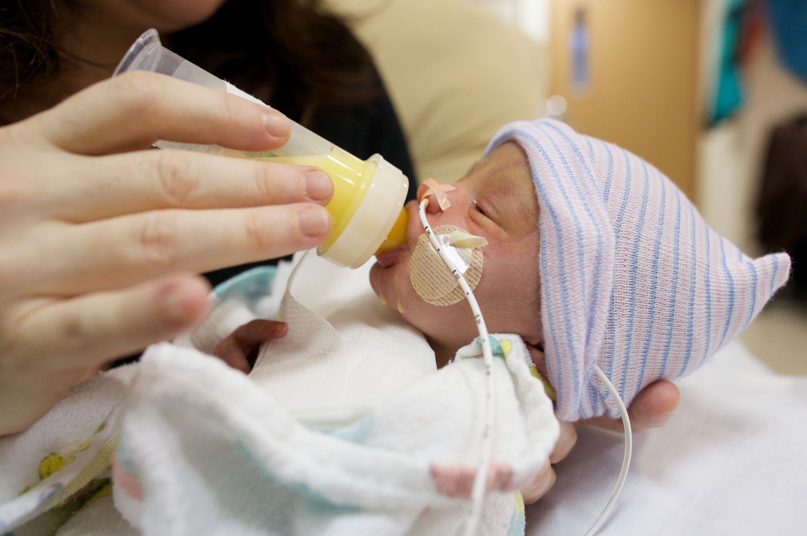


Intrauterine insults like malnutrition, maternal stress, drug, alcohol, or nicotine exposure
Birth trauma or perinatal trauma like a NICU stay
Relational trauma and attachment injuries like inconsistent caregiving, separation from parent, parental incarceration, or death
Physical or sexual abuse, household chaos, exposure to domestic or community violence, natural disasters, etc.

Slide 5
“Trauma occurs when an event elicits a real or perceived threat of danger, injury or death.”
-DSM 5
(American Psychiatric Association, 2013, p.271)

Slide 6
“Complex trauma describes...children’s exposure to multiple traumatic events...(that) are severe and pervasive, such as abuse or profound neglect. ”
(The National Child Traumatic Stress Network, 2018)
Notes:
“Complex trauma describes...children’s exposure to multiple traumatic events...(that) are severe and pervasive, such as abuse or profound neglect. They usually occur early in life and can disrupt many aspects of the child’s development and the formation of a sense of self. Since these events often occur with a caregiver, they interfere with the child’s ability to form a secure attachment.”

Slide 7


Notes:
Most trauma events have a distinct beginning and end point
C-PTSD is more complicated

Slide 8

Complex trauma impacts every developmental domain.

Slide 9
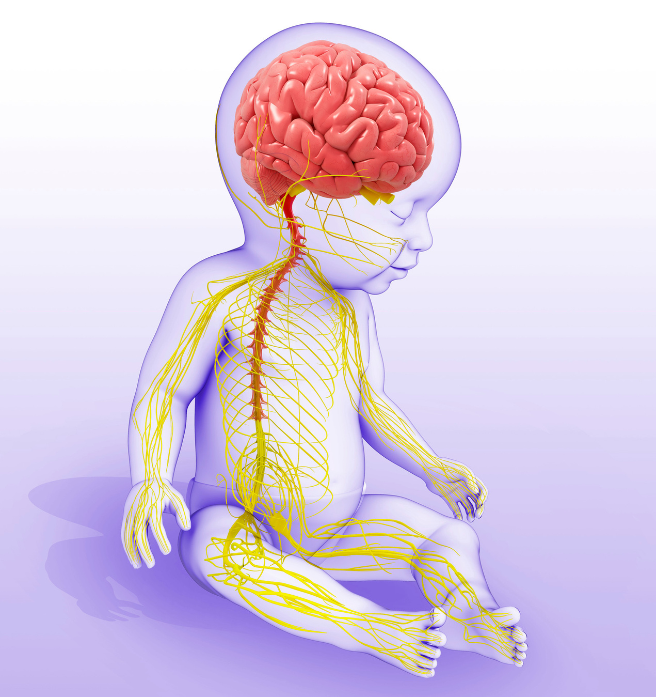
Brain
  Challenges in learning
  Impaired memory
  Lack of ability to regulate certain stress responses
  Cognitive challenges
  Low distress tolerance
  Poor executive functioning
  Impaired language development
Notes:
Brain- cognitive

Slide 10


Slide 11

Biology
  Sleep disturbance
  Metabolic impact
  Autoimmune disorders
  Fatigue
  Epigenetic impact
Notes:
Biology - the functional capacities of body

Slide 13

Behavior
  Poor impulse control
  Pervasive dysregulation
  Oppositional behavior
  Agitation
  Aggression
  Affect regulation issues
  Dissociation
  Anxiety and Depression
Notes:
Behavior- social/emotional impact

Slide 14
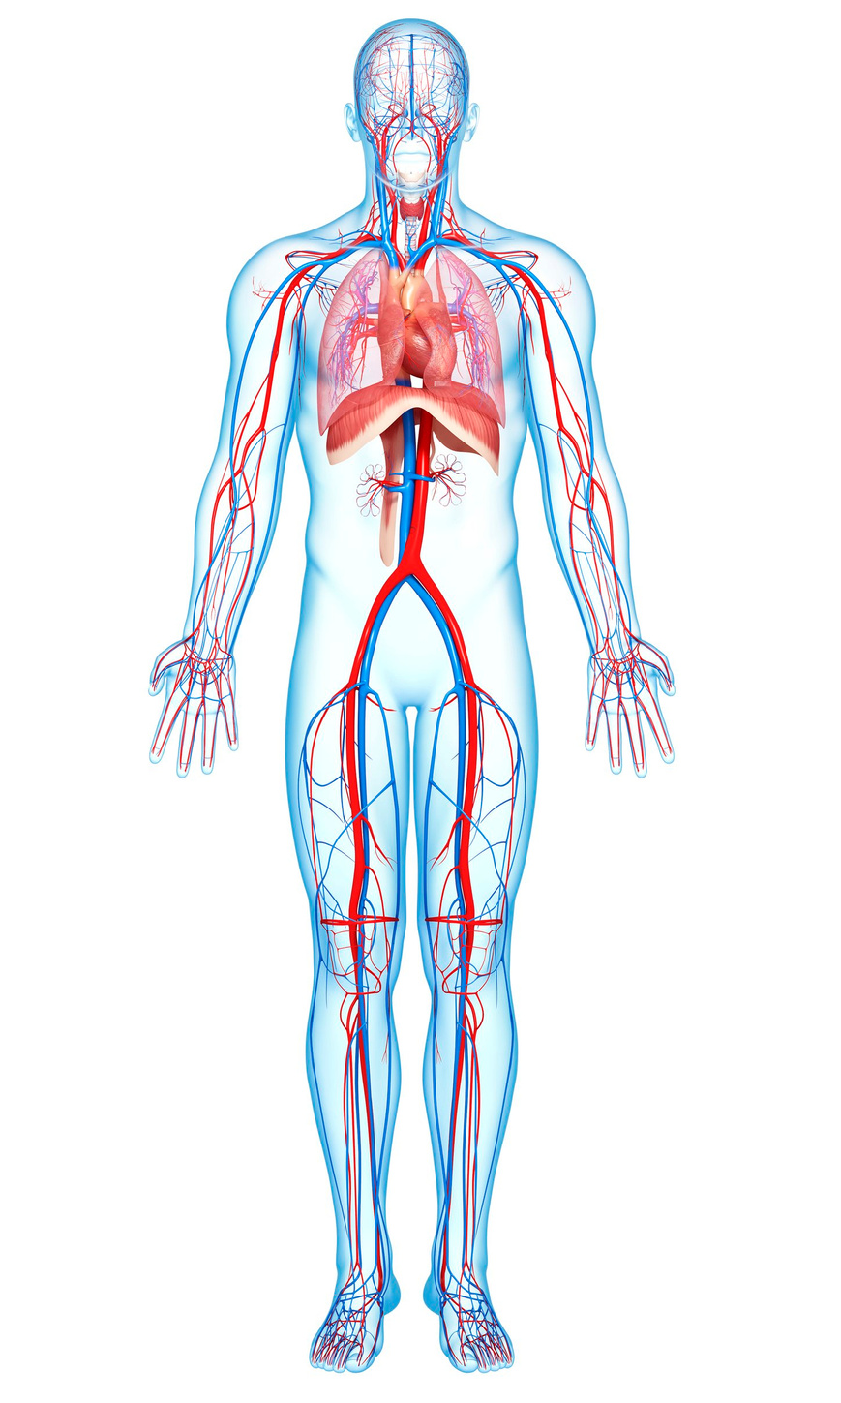
Body
  Sensory integration challenges
  Increased risk for digestive disorders
  Autonomic nervous system dysfunction such as elevated or decreased heart rate
  Increased risk for cancer, liver disease and broken bones
Notes:
Body - physical

Slide 16

Beliefs
Di
  Low self-esteem
  Identity issues
  Distrust and suspiciousness
  Shame
  The world is inherently unsafe

Slide 18

Seven Core Issues in Adoption and Permanency
Loss
(Roszia & Maxon, 2019)

Slide 19
Seven Core Issues in Adoption and Permanency
Rejection
(Roszia & Maxon, 2019)

Slide 20
Seven Core Issues in Adoption and Permanency
Shame & Guilt
(Roszia & Maxon, 2019)

Slide 21
Seven Core Issues in Adoption and Permanency
Grief
(Roszia & Maxon, 2019)

Slide 22
Seven Core Issues in Adoption and Permanency
Identity
(Roszia & Maxon, 2019)

Slide 23
Seven Core Issues in Adoption and Permanency
Intimacy
(Roszia & Maxon, 2019)

Slide 24
Seven Core Issues in Adoption and Permanency
Mastery &Control
(Roszia & Maxon, 2019)

Slide 25

Adoptive and Guardianship Parents Must
Recognize the impact of trauma
Notes:
Can not assume that love will fix things

Slide 26

Adoptive and Guardianship Parents Must
Recognize the impact of trauma
Build resilience by increasing positive childhood experiences
Notes:
Positive childhood experiences show dose-response associations with D/PMH and ARSES after accounting for exposure to ACEs. The proactive promotion of PCEs for children may reduce risk for adult D/PMH and promote adult relational health. Joint assessment of PCEs and ACEs may better target needs and interventions and enable a focus on building strengths to promote well-being. Findings support prioritizing possibilities to foster safe, stable nurturing relationships for children that consider the health outcomes of positive experiences.
AMA Pediatr. 2019;173(11):e193007. doi:10.1001/jamapediatrics.2019.3007 Published online September 9, 2019. Corrected on September 30, 2019.

Slide 27
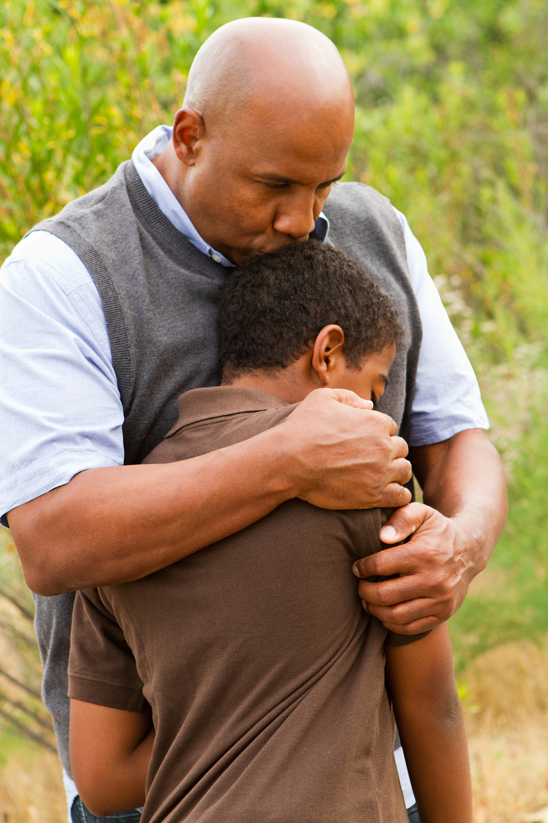


  feeling able to talk to your family about your emotions
  feeling your family stood by you during difficult times
  enjoying participation in community traditions
  feeling a sense of belonging in school
  feeling supported by friends
  having at least two non-parent adults who take a genuine interest in you
  feeling safe and protected by an adult in your home
·(Bethell, Jones, Gombojav, Linkenbach, & Sege, 2019, p. 6)

Slide 28

Adoptive and Guardianship Parents Must
Recognize the impact of trauma
Parent
with a therapeutic lens
Build resilience by increasing positive childhood experiences

Slide 29

Adoptive and Guardianship Parents Must
Recognize the impact of trauma
Parent
with a therapeutic lens
Be willing to seek out help
Build resilience by increasing positive childhood experiences

Slide 30

Reflection

Slide 31
References
American Psychiatric Association. (2013). Diagnostic and statistical manual of mental disorders (5th ed.).
Bethell, C., Jones, J., Gombojav, N., Linkenbach, J., & Sege, R. (2019). Positive Childhood Experiences and Adult Mental and Relational Health in a Statewide Sample Associations Across Adverse Childhood Experiences Levels. JAMA Pediatrics, Published online September 9, 2019. Corrected on September 30, 2019.
Leve, L. D., Oro, V., Natsu, M. N., Harold, G. T., Neiderhise, J. M., Ganiban, J. M., . . . DeGarmo, D. S. (2024). The pernicious role of stress on intergenerational continuity of psychopathology. Development and Psychopathology, 1-14
doi:10.1017/S0954579424000191.
Roszia, S., & Maxon, A. (2019). Seven Core Issues in Adoption and Permanency Davis. Seven Core Issues in Adoption and Permanency. Jessica Kingsley Publishers. Kindle Edition. London: Jessica Kingsley.
The National Child Traumatic Stress Network. (2018, May 25). Complex Trauma. Retrieved from The National Child Traumatic Stress Network: https://www.nctsn.org/what-is-child-trauma/trauma-types/complex-trauma
The National Quality Improvement Center for Adoption and Guardianship. (2018). The Continuing Journey of Children and Families An Informational Guide for those Parenting by Adoption or Guardianship. The Children's Bureau.

