Slide 1



AGPT SESSION 3
Trainer Name and Credentials

Slide 2

Objectives
  Understand attachment and the impact of relational health on child development
  Discuss connections with children’s family of origin and adoption disclosure
  Explore the concept of “shark music”
  Questions and reflections

Slide 3
Attachment is a profound reciprocal physical and emotional relationship between a parent and child that endures and sets the stage for all future intimate and trusting relationships.

Slide 4

“The quality of attachment that an infant develops with a specific caregiver is largely determined by the caregiver’s response to the infant when the infant’s attachment system is ‘activated’. For example when...”
  when child is ill
  physically hurt
  emotionally upset
  frightened
(Benoit, 2004, p. 542)
(Benoit, 2004, p. 542)

Slide 5

“The quality of attachment that an infant develops with a specific caregiver is largely determined by the caregiver’s response to the infant when the infant’s attachment system is ‘activated’. For example when...”
  when child is ill
  physically hurt
  emotionally upset
  frightened
(Benoit, 2004, p. 542)
(Benoit, 2004, p. 542)

Slide 6

“The quality of attachment that an infant develops with a specific caregiver is largely determined by the caregiver’s response to the infant when the infant’s attachment system is ‘activated’. For example when...”
  when child is ill
  physically hurt
  emotionally upset
  frightened
(Benoit, 2004, p. 542)
(Benoit, 2004, p. 542)

Slide 7

“The quality of attachment that an infant develops with a specific caregiver is largely determined by the caregiver’s response to the infant when the infant’s attachment system is ‘activated’. For example when...”
  when child is ill
  physically hurt
  emotionally upset
  frightened
(Benoit, 2004, p. 542)
(Benoit, 2004, p. 542)

Slide 8

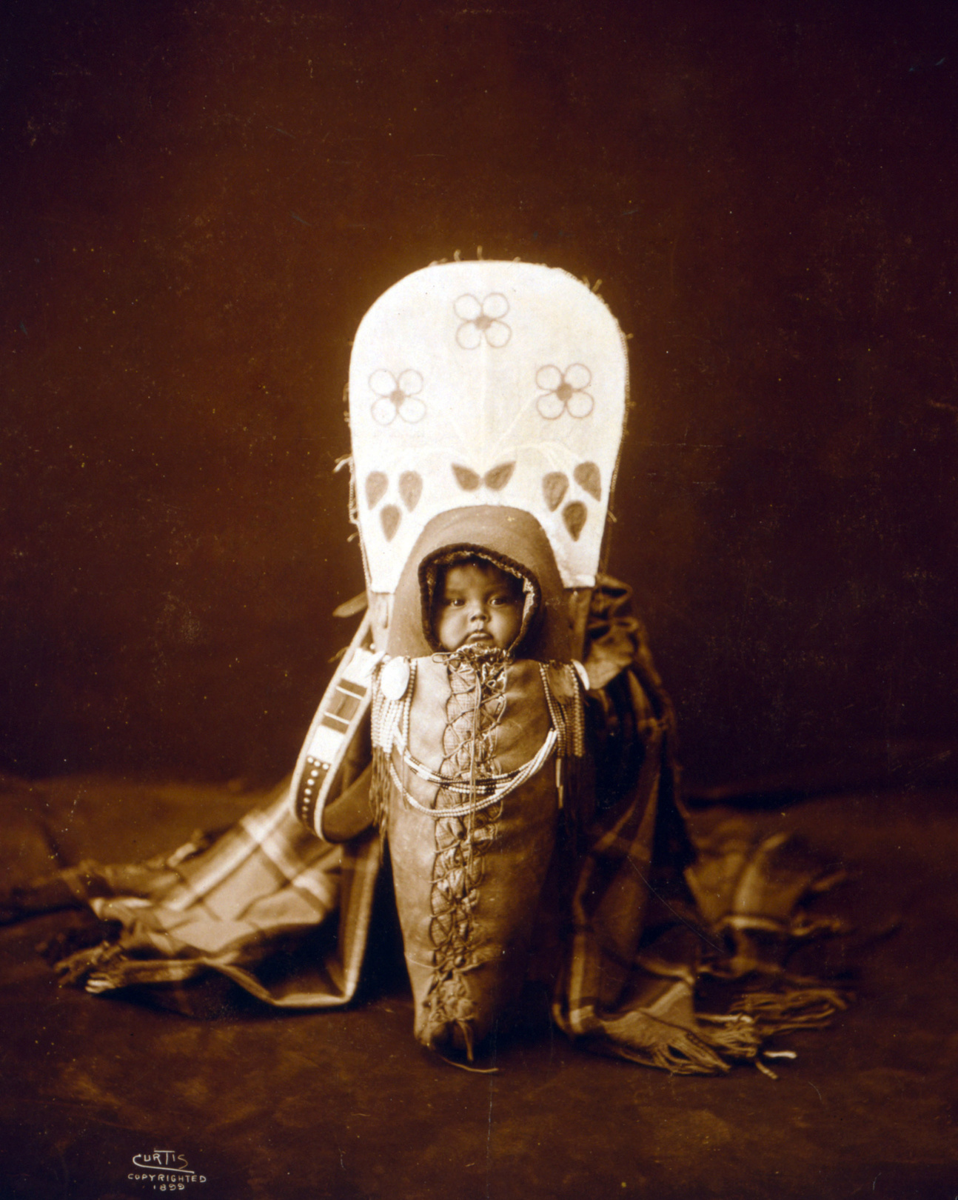


Notes:
Carol George-being close to attachment figures is a biological imperative.
Attachment behaviors may look different in different cultures, but the it’s that feeling of safety and how that impacts the nervous system that is paramount.
Abuse, neglect, maltreatment even early medical problems can interrupt the attachment cycle
Attachment is far more then just caregiving skills or teaching and relational activities. It's the ability for the child to see the parent to see their parent or their attachment figures as a place of safety,
It’s only through having this haven that a child internalizes this and feels a sense of safety and comfort in the world.

Slide 9
Attachment is a spectrum.
Notes:
We want to remember that attachment is a spectrum and it’s not fixed. It’s not on or off.
Can change over time, can change through the life span and can individuals can be attached in different ways to different people in their lives.
At Harmony we really avoid pathologizing attachment challenges in children with trauma histories, because children and adults can increase their capacity to attach and improve their relation health.
These DX often cause parents to give up, to shut down, and to feel like there's no hope
It’s important to remember that early attachment challenges can be serious they can impact our relationship throughout the life span, but it’s not hopeless.
We use the work of Bruce Perry here at Harmony as a basis for our, our thinking, and our treatment in many cases. And doctor Perry describes two young girls Virginia and Laura, in his book, The Boy Who’ Was Raised As a Dog.
These girls had really tough early lives, maltreatment and trauma and they did not have good quality attachments.
“Like people who learn a foreign language later in life, Virginia and Laura will never speak the language of love (attachment) without an accent.”
So, yes, people can change the way they attach. They can change their relational health, and these experiences still may impact them though out their lives
There is so much hope for healing, so much capacity to change for children and we’re going to look at how we can support kids in their relational healing.

Slide 10
Attachment is a spectrum.

Slide 11





Secure Attachment
  has a quality relationship with at least one caregiver
  trusts that the caregiver will meet their needs
  turns to caregiver for comfort

Slide 12
Disorganized Attachment
  struggles in relationship
  push/pull relational dynamic
Secure Attachment
  has a quality relationship with at least one caregiver
  trusts that the caregiver will meet their needs
  turns to caregiver for comfort

Slide 13
Disorganized Attachment
  struggles in relationship
  push/pull relational dynamic
Secure Attachment
  has a quality relationship with at least one caregiver
  trusts that the caregiver will meet their needs
  turns to caregiver for comfort
Insecure
Attachment
  Avoidant, Cactus Child
  Anxious, Velcro Child

Slide 14





Slide 15

Notes:
Early relational experiences matter

Slide 16
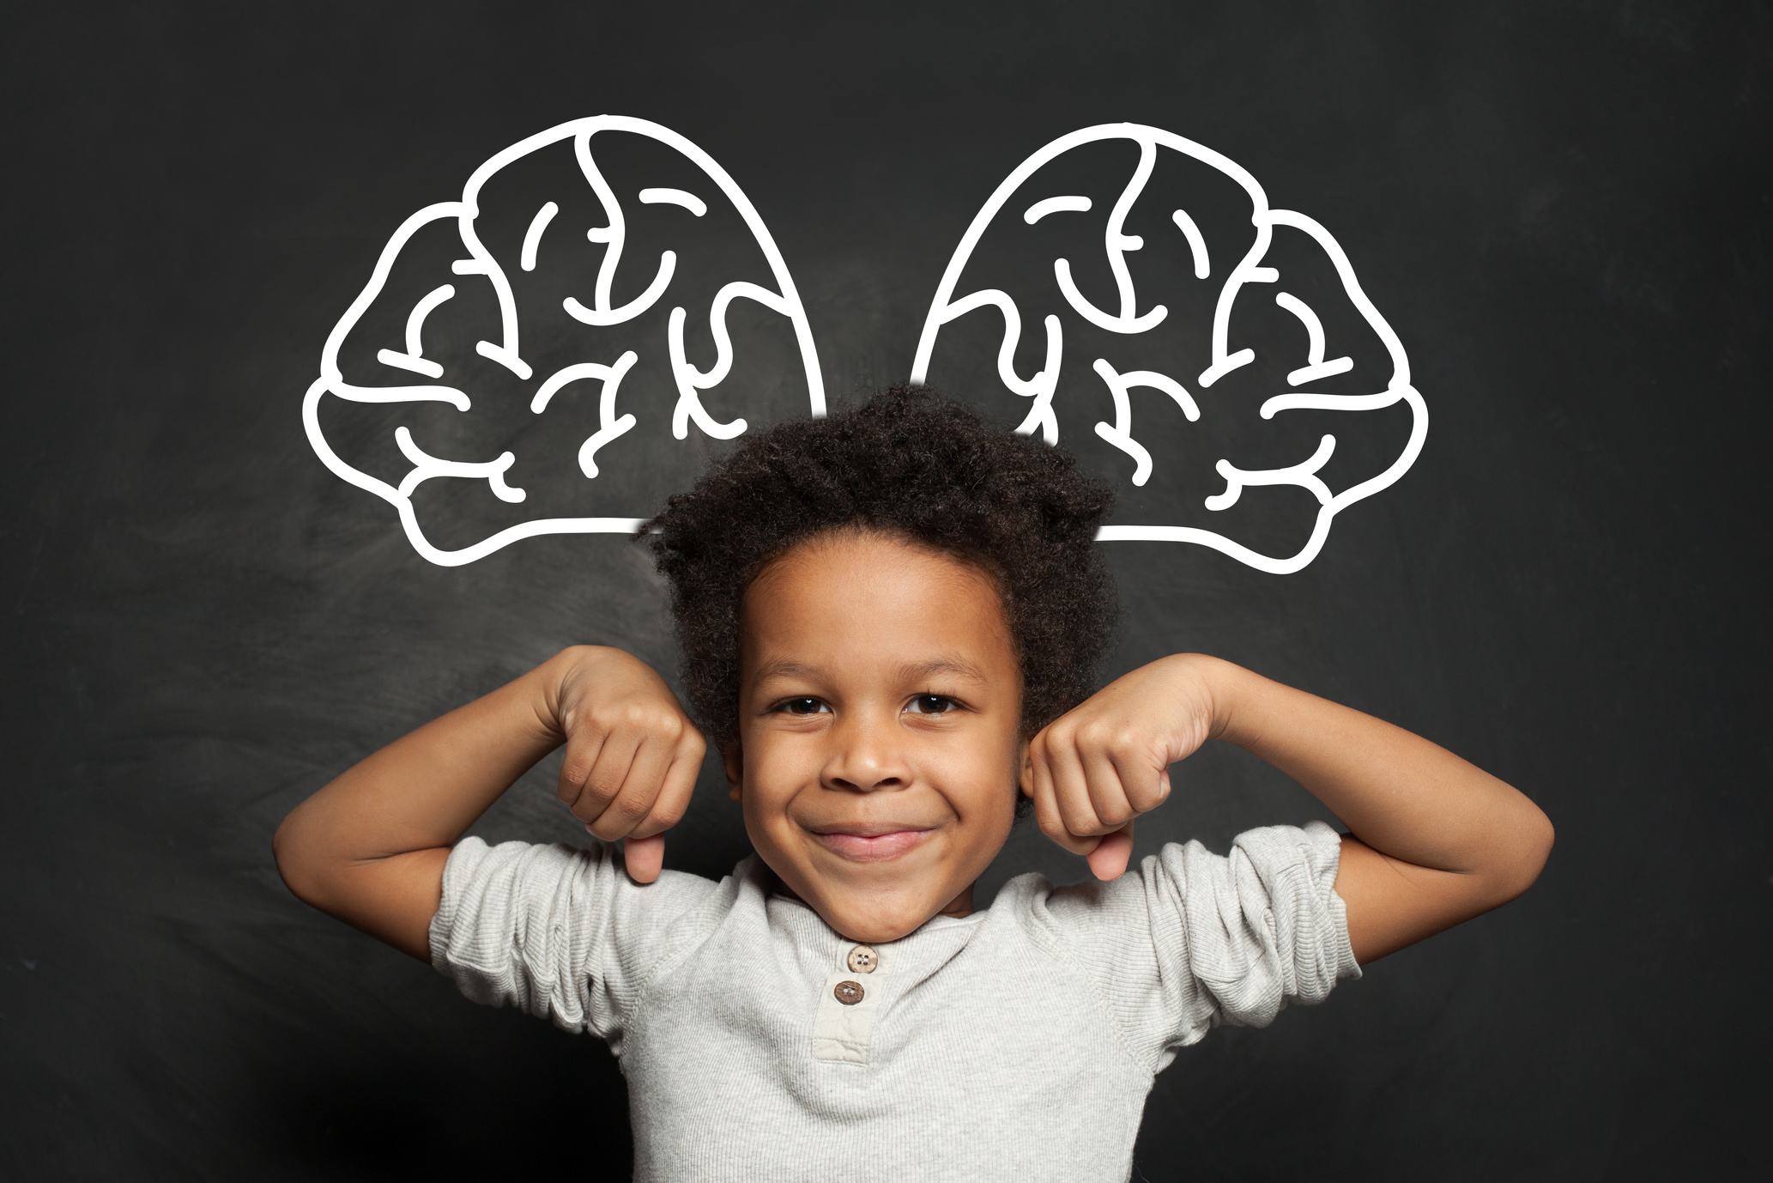


Brain
Development

Slide 17
Brain
Development
Emotional Development

Slide 18
Brain
Development
Emotional Development
Self
Regulation

Slide 19


Slide 20


Slide 21



“The more healthy relationships a child has, the more likely he will be to recover from trauma and thrive.”
Bruce D. Perry, M.D., Ph.D.
(Perry & Szalavitz, 2017, p.258)

Slide 22
For many children and youth, this will include relationships with the child’s family of origin.

Slide 23

Ongoing contact with birth family or other relatives reduces the adopted child’s sense of “divided loyalties” (Neil , 2018) and self-blame or shame. (Riley & Singer, 2019)

Slide 24
Ongoing contact with birth family or other relatives reduces the adopted child’s sense of “divided loyalties” (Neil , 2018) and self-blame or shame. (Riley & Singer, 2019)
Post-permanency connections with birth family strengthens the child’s understanding of their cultural, racial and ethnic identity. (Child Information Gateway, 2019)
Notes:
Research indicates that ongoing contact is positive for adoptees

Slide 25
Ongoing contact with birth family or other relatives reduces the adopted child’s sense of “divided loyalties” (Neil , 2018) and self-blame or shame. (Riley & Singer, 2019)
Post-permanency connections with birth family strengthens the child’s understanding of their cultural, racial and ethnic identity. (Child Information Gateway, 2019)
Contact and shared information about the family of origin can alleviate a child’s feelings of abandonment or anxiety regarding the birth family’s wellbeing. (Riley & Singer, 2019)

Slide 26
Ongoing contact with birth family or other relatives reduces the adopted child’s sense of “divided loyalties” (Neil , 2018) and self-blame or shame. (Riley & Singer, 2019)
Post-permanency connections with birth family strengthens the child’s understanding of their cultural, racial and ethnic identity. (Child Information Gateway, 2019)
Contact and shared information about the family of origin can alleviate a child’s feelings of abandonment or anxiety regarding the birth family’s well being. (Riley & Singer, 2019)
Ongoing contact promotes and supports the child’s attachment with their adoptive parents. (Riley & Singer, 2019) In fact youth with access to information regarding their birth families report better communication with their adoptive parents. (Farr, et.al, 2014)

Slide 28

Disclosure:
Parents proactively telling a child of his or her adoption
Nondisclosure:
Waiting until the child discovers on his own or is told by a third party about the adoption
(MacIntyre, 1990, p. 828)

Slide 29



Adoption Disclosure Research
“...those who discovered their adoptions before age 3 (essentially those who felt they had “always known” of their adoptions) reported better outcomes...”
(Baden, et al., 2019, p.1160)

Slide 30
Adoption Disclosure Research
“...those who discovered their adoptions before age 3 (essentially those who felt they had “always known” of their adoptions) reported better outcomes...”
In a 2019 study, those who learn their adoption status between the ages of 11 and 20, report the lowest quality of life scores.
(Baden, et al., 2019, p.1160)
(Baden, et al., 2019)

Slide 31
Adoption Disclosure Research
“...those who discovered their adoptions before age 3 (essentially those who felt they had “always known” of their adoptions) reported better outcomes...”
In a 2019 study, those who learn their adoption status between the ages of 11 and 20, report the lowest quality of life scores.
“...adoptees reported
that delayed discovery was associated with problematic outcomes that affected
their emotions, relationships, and physical health."
(Baden, et al., 2019, p.1160)
(Baden, et al., 2019)
(Baden, et al., 2019, p.1169)

Slide 32

Transparency in adoption is paramount. It can also be incredibly challenging.

Slide 34

Paying attention to our “shark music” alerts us that we are upset.
Instead of reacting from distress, we can train ourselves to accurately interpret the child’s actions and provide nurture, even when hearing “shark music”.

Slide 35

Reflection and Discussion

Slide 36
References
Baden, A. L., Shadel, D., Morgan, R., White, E. E., Harrington, E. S., Christian, N., & Bates, T. A. (2019). Delaying Adoption Disclosure: A Survey of Late Discovery Adoptees. Journal of Family Issues, 1154– 1180.
Benoit, D. (2004). Infant-parent attachment: Definition, types, antecedents, measurement and outcome. Paediatric Child Health, 541-545.
Child Welfare Information Gateway. (2019). Helping your adopted children maintain important relationships with family. Washington, DC: U.S. Department of Health and Human Services, Administration for Children and Families, Children's Bureau.
Farr, R., Grant-Marsney, H., Musante, D., Grotevant, H., & Wrobel, G. (2014). Adoptees' Contact with Birth Relatives in Emerging Adulthood. Journal of Adolescent Research, 45-66.
MacIntyre, J. C. (1990). Resolved: Children should be told of their adoption before they ask. Journal of the American Academy of Child & Adolescent Psychiatry, 828-833 doi:10.1097/00004583-199009000-00025.
Neil, E. (2018). Rethinking adoption and birth family contact: is there a role for the law? Family Law, 1178-1182.
Perry, B. D., & Szalavitz, M. (2017). The Boy Raised as a Dog. New York: Basic Books.
Quiroga, M. G., & Hamilton-Gianchritsis, C. (2016). Attachment Styles in Children Living in Alternative Care: A Systematic Review of the Literature. Child Youth Care Forum, 625-653.
Riley, D. B., & Singer, E. (2019, August 2). Connections Matter: Relationships with Birth Families are Important for Foster, Adopted Children. Retrieved from The Imprint Youth and Family News: https://imprintnews.org/adoption/connections-matter-relationships-with-birth-families-are-important-for-foster-adopted-children/36174
Sakman, E., & Zayas, V. (2020, October 27). Human Attachment and Aﬁliation. Retrieved from Oxford Research Encyclopedia Psychology: https://oxfordre.com/psychology/display/10.1093/acrefore/9780190236557.001.0001/acrefore-9780190236557-e-276

